Slide 1


MOBILE SEVA APPSTORE
(https://apps.mgov.gov.in/)
Notes:
Title slide with customer logo
Customer logo to be placed on the right
Use this slide if you need to create a presentation in conjunction/partnership with a
client/customer. Logo placement cannot be changed
Title should not exceed beyond 3 lines, font size 30-34, Arial Headings (Font size for the title of
the PPT can vary between 30-34, Arial Headings, Bold depending on the amount of text, however should not be
smaller than 30 font size)
Name should not exceed beyond 1 line, Designation should not exceed beyond 1 line , font size to
remain at 18,Arial Headings
Keep this slide simple just the logo, title, name and designation to appear.
No other graphic elements or any design, photograph, image can be added to this slide , alignment to remain the same

Slide 2

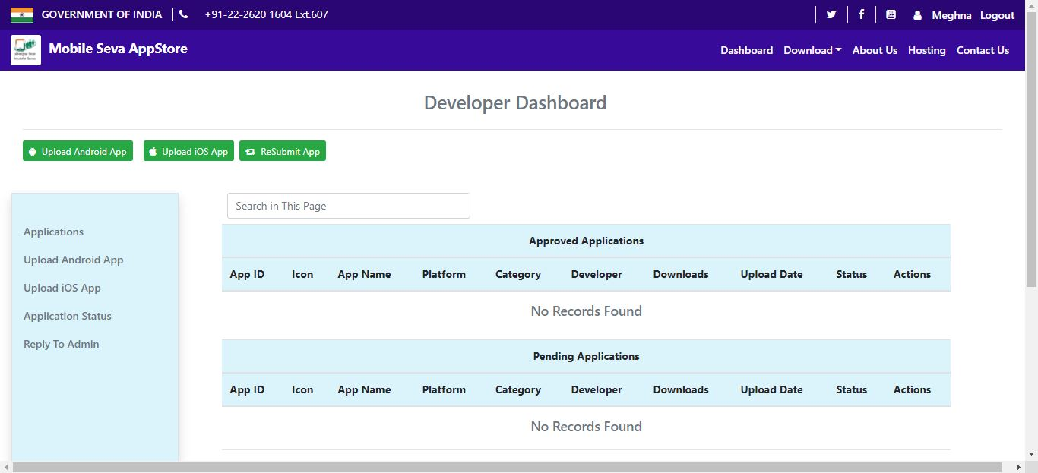
Developer Dashboard
Notes:
Content Slide: This is usually the most frequently used slide in every presentation.
Use this slide for Text heavy slides. Text can only be used in bullet points
Title Heading – font size 30, Arial Heading
Slide Content – Should not reduce beyond Arial body font 16
If you need to use sub bullets please use the indent buttons located next to the bullets buttons in the tool bar and this will automatically provide you with the second, third, fourth & fifth level bullet styles and font sizes
Please note you can also press the tab key to create the different levels of bulleted content

Slide 3
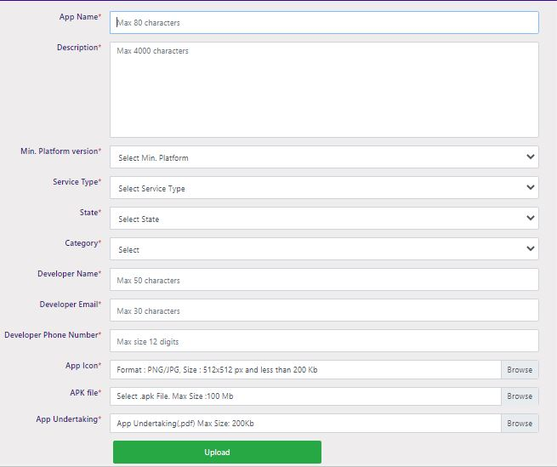
Upload Android App
Notes:
Content Slide: This is usually the most frequently used slide in every presentation.
Use this slide for Text heavy slides. Text can only be used in bullet points
Title Heading – font size 30, Arial Heading
Slide Content – Should not reduce beyond Arial body font 16
If you need to use sub bullets please use the indent buttons located next to the bullets buttons in the tool bar and this will automatically provide you with the second, third, fourth & fifth level bullet styles and font sizes
Please note you can also press the tab key to create the different levels of bulleted content

Slide 4
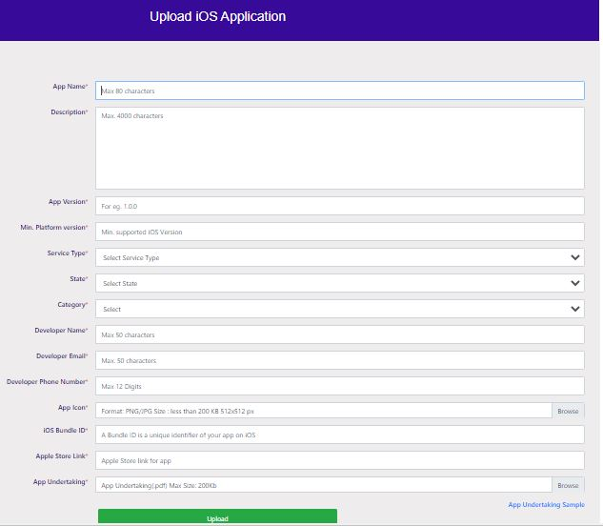
Upload iOS App Link

Slide 5
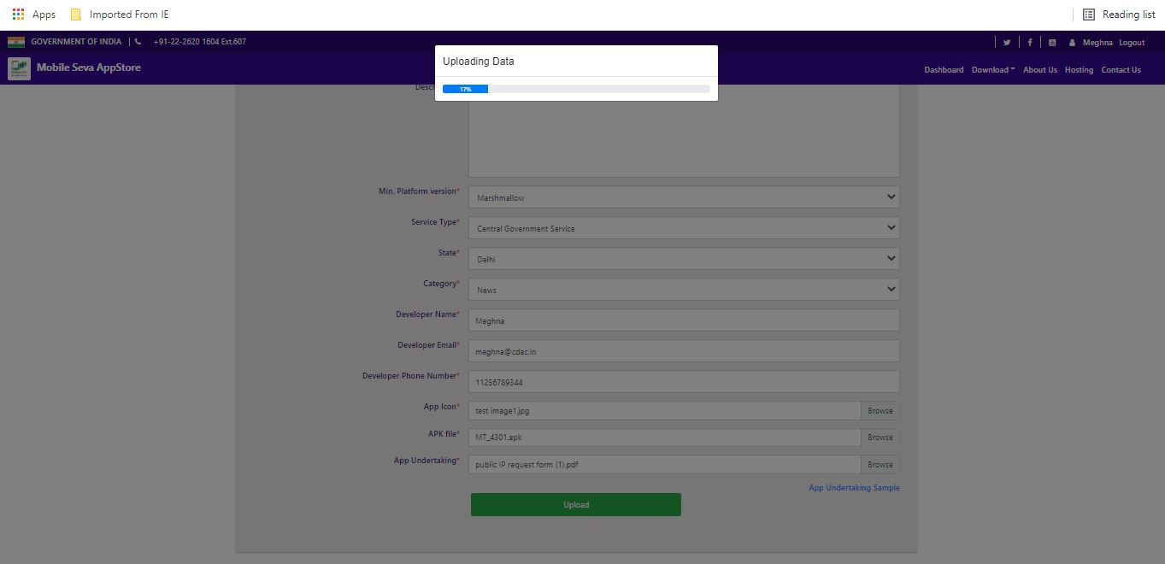

Slide 6
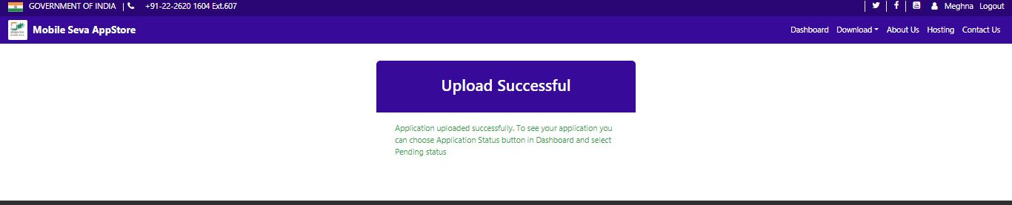
Upload Successful Page

